Slide 1
Tutorial on VoiceSauce - A program for voice analysis
Yuan Chai
University of California Los Angeles
yuanchai@g.ucla.edu
02/10/2023

Slide 2
Goal of the workshop
Have a basic understanding of the rationale and usage of VoiceSauce;
Get hands-on experience of using VoiceSauce to process audio files;
Visualize and interpret data in Excel
(Try some visualization using R code!)

Slide 3
What is VoiceSauce
VoiceSauce is a software that can be used to analyze acoustic measurements related to voicing.
Compared to Praat, VoiceSauce specializes in measuring parameters related to voice quality:
Spectral tilt (H1-H2, H2-H4), noise (HNR), voicing amplitude (SoE). Those measures indicate whether there is glottal constriction or F0 irregularity in the voicing.
VoiceSauce can also calculate measures that Praat can calculate:
Pitch (F0), vowel formant, duration, intensity (RMS Energy)

Slide 4
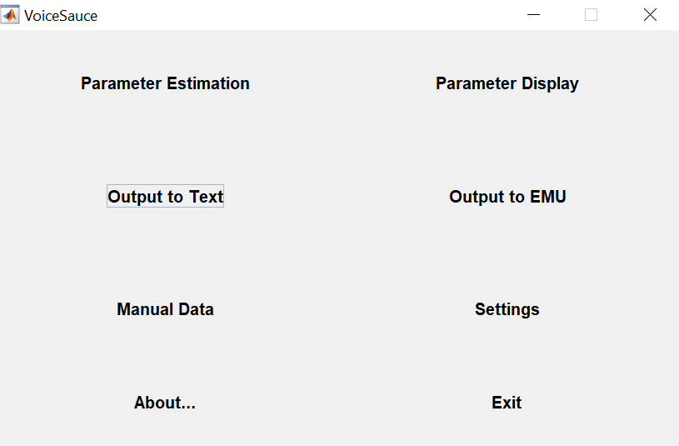
What does VoiceSauce look like
If you want to visualize the data in VoiceSauce
Step 2
Step 3
If you spot errors in the output and want to manually add data
Step 1

Slide 5
Output from VoiceSauce
VoiceSauce output one datapoint every 1 millisecond.
VoiceSauce can also calculate mean
Either the overall mean,
Or you can specify how many intervals you want to divide a sound file into, and calculate the mean of each interval.

Slide 6
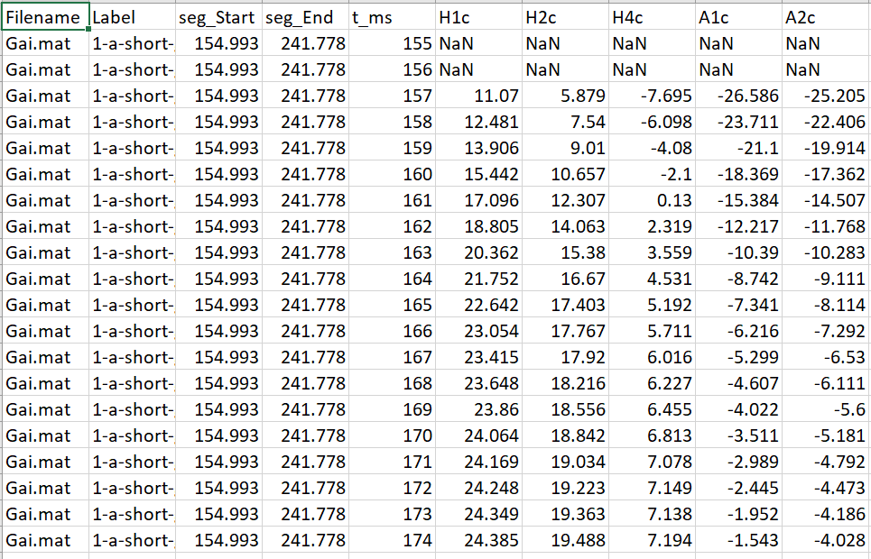
All data points:

Slide 7
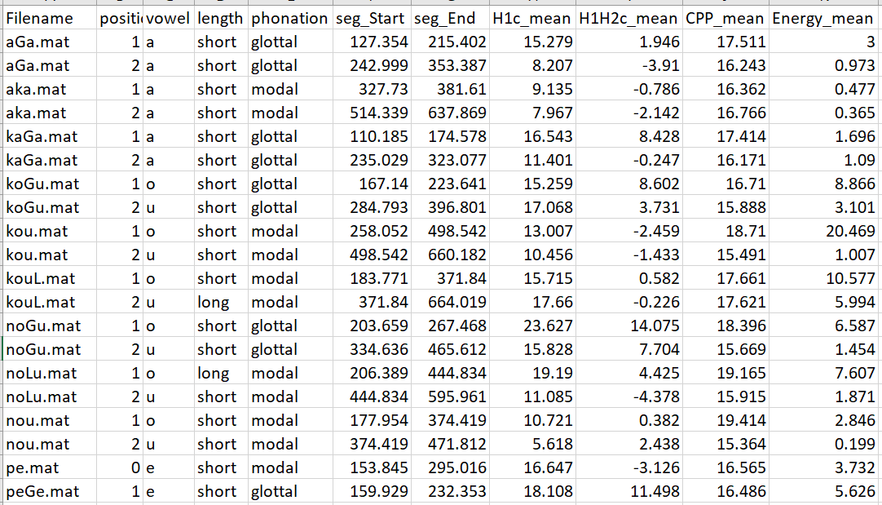
Just the mean

Slide 8
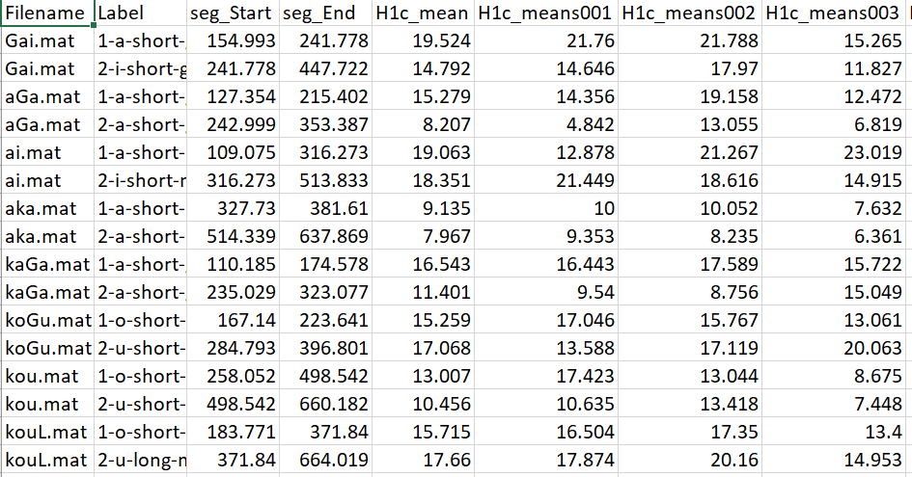
Means of three equal-timed intervals for each file

Slide 9
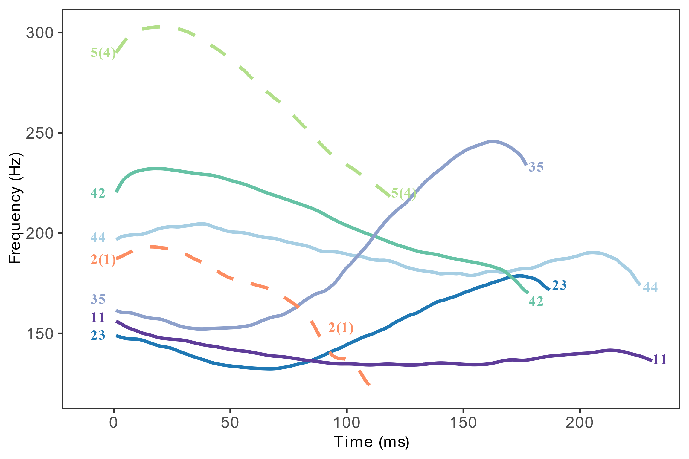
What can you draw/analyze using output from VoiceSauce
Pitch track (F0 track of the seven tones in Xiapu Min)

Slide 10
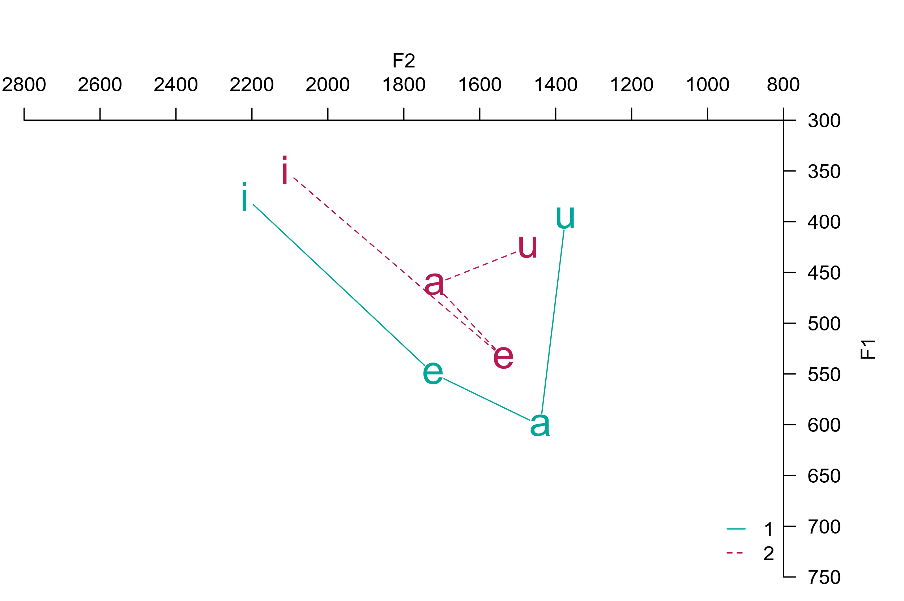
What can you draw/analyze using output from VoiceSauce
Vowel chart (stressed and unstressed vowels in Cahuilla)

Slide 11
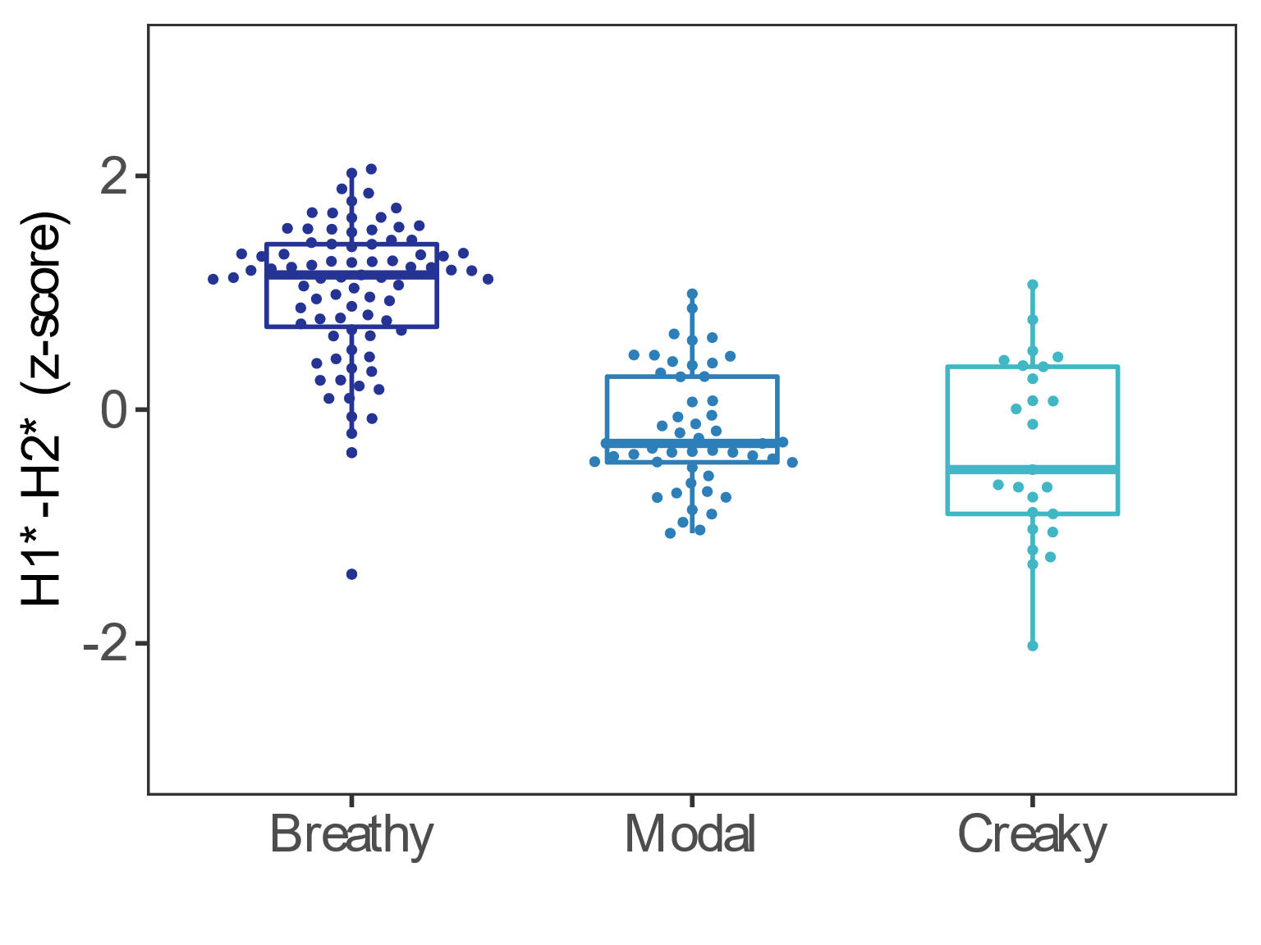
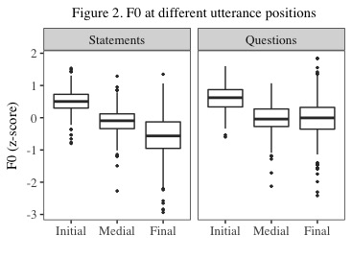
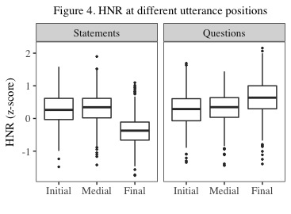
What can you draw/analyze using output from VoiceSauce
Boxplots of various measures
H1*—H2*
F0
Harmonic-to-noise ratio

Slide 12
Summary of the parameters
F0: F0 from Straight (strF0), Snack (sF0), Praat (pF0), Subharmonic to harmonic ratio F0 (shrF0)
Formant: Formant frequencies and bandwidths by Snack (sF1, sF2) and by Praat (pF1, pF2)
Spectral measures: H1, H2, H1H2c, H2H4c
Energy: Energy (overall); Strength of Excitation (SoE)
Noise: Cepstral Peak Prominence (CPP); Harmonic to noise ratios: HNR05 (0-500Hz), HNR15 (0-1500Hz), HNR25 (0-2500Hz), HNR35 (0-3500Hz), Subharmonic to harmonic ratio: SHR

Slide 13
Sample research questions:
Is the consonant pre-glottalized or post-glottalized?
Are vowels following ejectives more glottalized than vowels following non-ejectives?
Do implosive have stronger voicing than non-implosive?
Does vowel quality differ between stressed and unstressed syllables?
Do vowels after voiceless stops have a higher F0 than vowels after voiced stops?
What is the F0 contour and shape of the tones in the language?
Do vowels following aspirated stops have a breathy voice quality?

Slide 14
How to download and use VoiceSauce
Windows users: Standalone .exe file
Mac users: Install Matlab and run the scripts in Matlab
Refer to https://yuanchaiyc.github.io/website/subpages/VS-tutorial.html for detailed installation instructions

Slide 15
Case study for today
The acoustics of V and VʔV in Hawaiian
Hawaiian has phonemic glottal stop:
aha | “what”
ʔaha | “line, life”
noːu | “yours”
noʔu | “mine”
(Data and recordings from the UCLA Phonetics Lab Archive http://archive.phonetics.ucla.edu/Language/HAW/haw_word-list_1973_01.html#1)

Slide 16

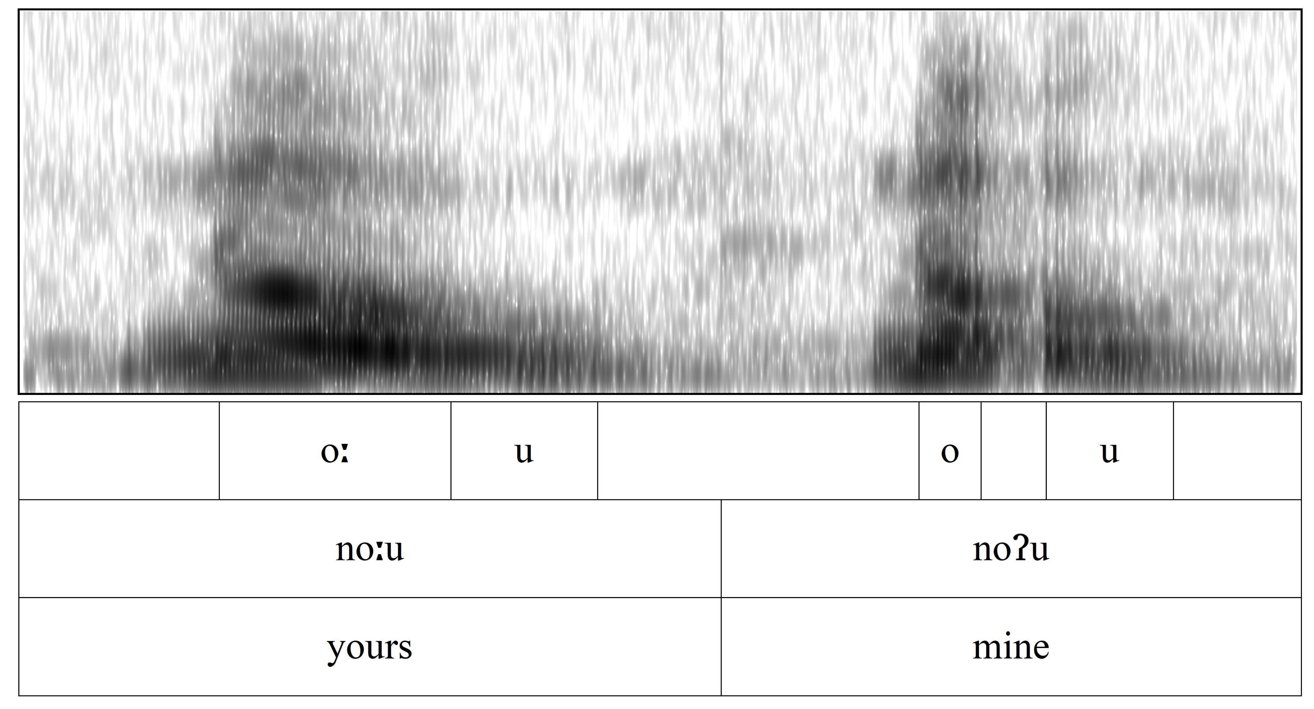
Case study for today
Research question: Are the vowels surrounding the glottal stop creakier than the plain vowels?
noːu vs. noʔu

Slide 17
Case study for today
Word list:
word | gloss | word | gloss | word | gloss
pe | "thus" | peːpeː | "crushed" | peʔe | "to hide (oneself)"
nou | "to throw" | noːu | "yours" | noʔu | "mine"
kou | "yours" | kouː | "moist" | koʔu | "mine"
aka | "shadows" |  |  | aʔa | "roots"
 |  |  |  | kaʔa | "to roll"

Slide 18
Case study for today
Parameters of interest:
F0
Harmonic amplitude: H1, H1—H2
The lower the harmonic amplitude, the more glottal constriction
Noise: Harmonic-to-noise ratio (HNR05, meaning between 0 to 500 Hz)
The lower the HNR, the noisier the signal
Amplitude of voicing: Strength of excitation (SoE)
Glottalization tends to results in lower amplitude in voicing (SoE)

Slide 19
Getting started
Prepare data in Praat
Create a Textgrid
Segment and annotate the target segment
Save the Textgrid
either as for the whole recording
or split the recording into individual target words – RECOMMENDED
You can use Praat scripts or Praat plugins to chop a long recordings into smaller chunks. Come talk to me if you want to know more about the tools!

Slide 20
Getting started
Annotation strategy for the current task
Segment out each vowel (monophthongs or nuclei and glide in dipthongs)
e.g. [peːpeː] → Segment out two [eː]s
e.g. [nou] → Segment out [o] and [u]
Assign label at the word level and the segment level
Word level: peLpeL (use “L” to replace diacritic [ː] because VS does not allow special symbols)
Segment level:
1-e-long-modal
position-vowel-length-phonation

Slide 21
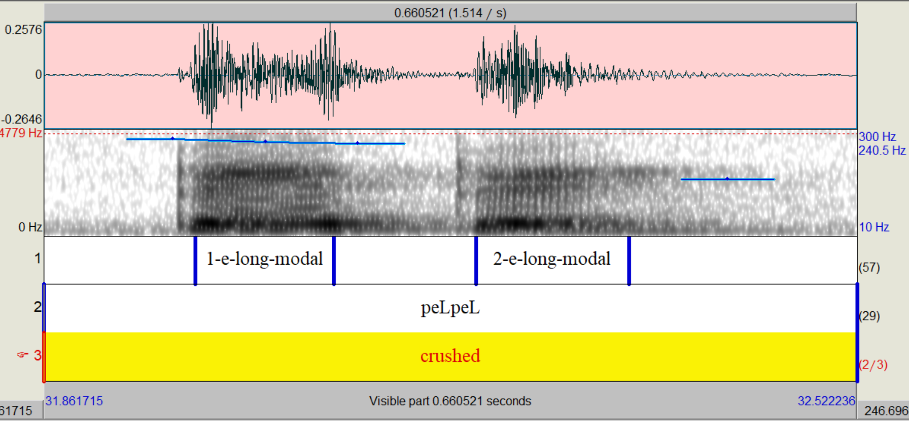
Getting started

Slide 22
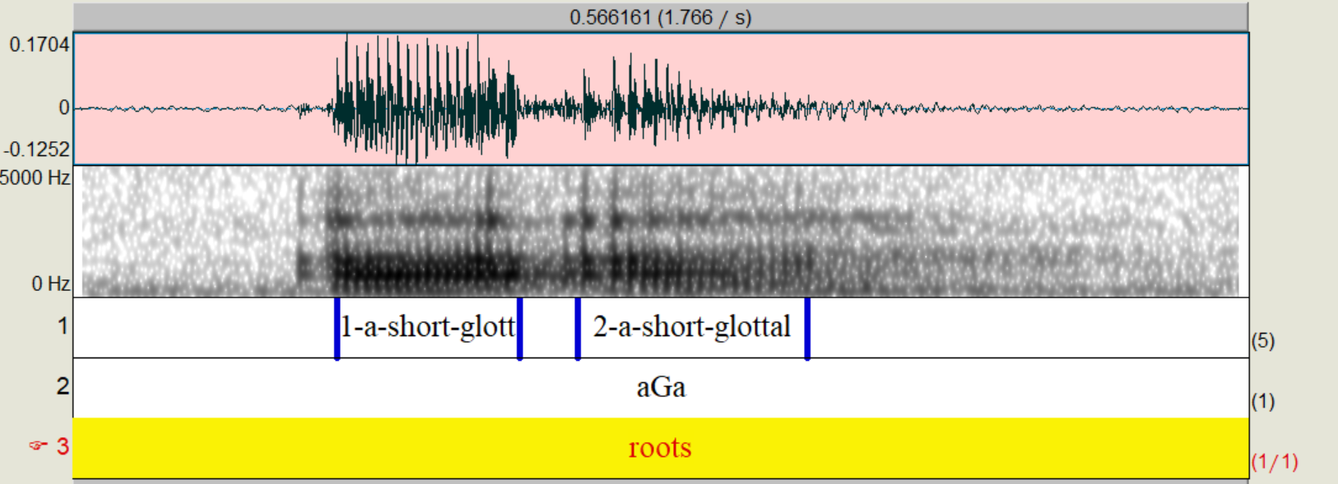
Getting started

Slide 23
Getting started
Download the preprocessed data here:
https://yuanchaiyc.github.io/website/subpages/sample/Hawaiian_data.zip

Slide 24
Pass on the .wav and .Textgrid to VoiceSauce
Step 1

Slide 25
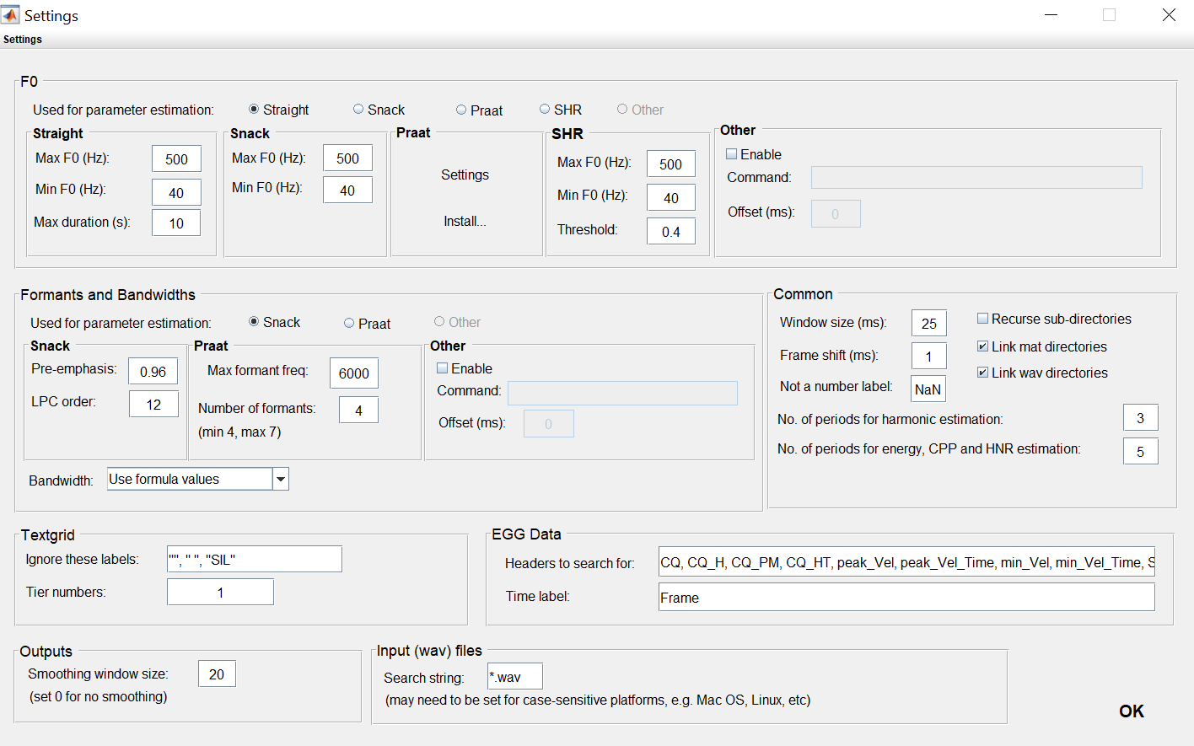
Step 1: Settings

Slide 26
Step 2: Parameter estimation
Step 2

Slide 27
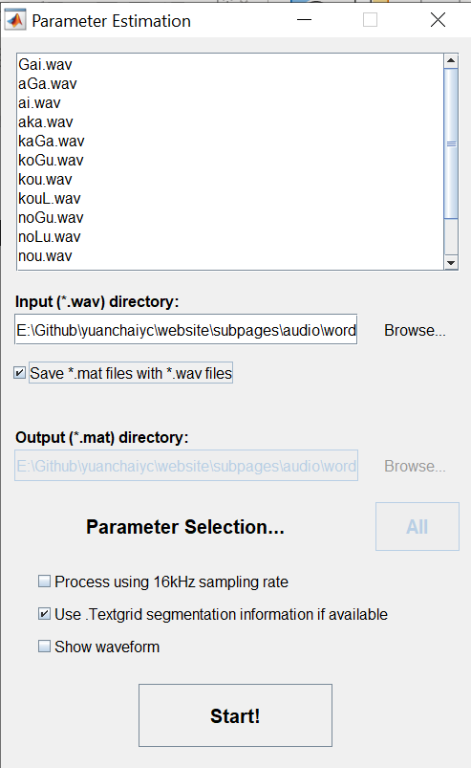

Slide 28
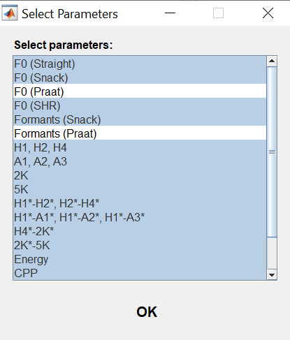
Step 2: Parameter estimation
If you are using Matlab online, make sure you deselect all the measures involving Praat.

Slide 29
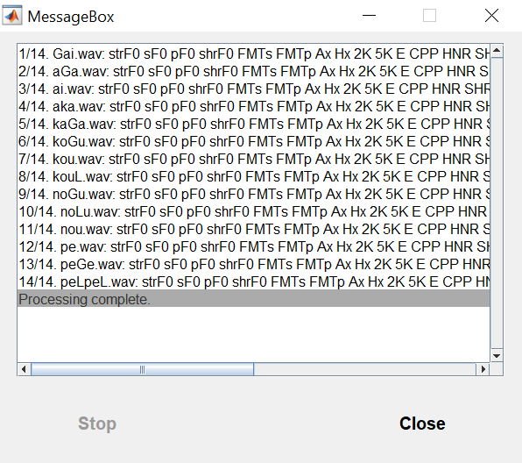
Step 2: Parameter estimation

Slide 30
Step 3: Output to text
Step 3

Slide 31
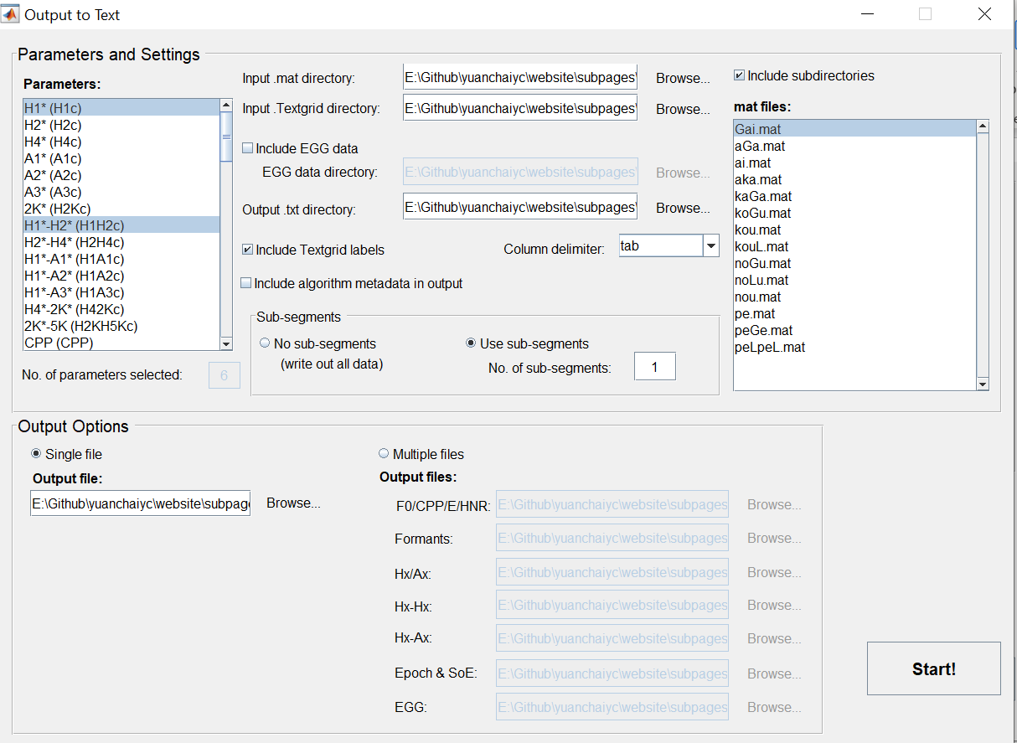
Parameters to select for today:
H1*
H1*-H2*
HNR05
strF0
sF1
sF2
SoE

Slide 32
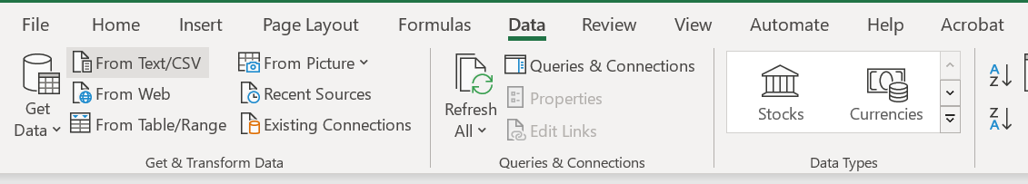
Step 4: Visualize the output in Excel
Open output.txt in Excel:
Open Excel → Data → From Text/CSV

Slide 33
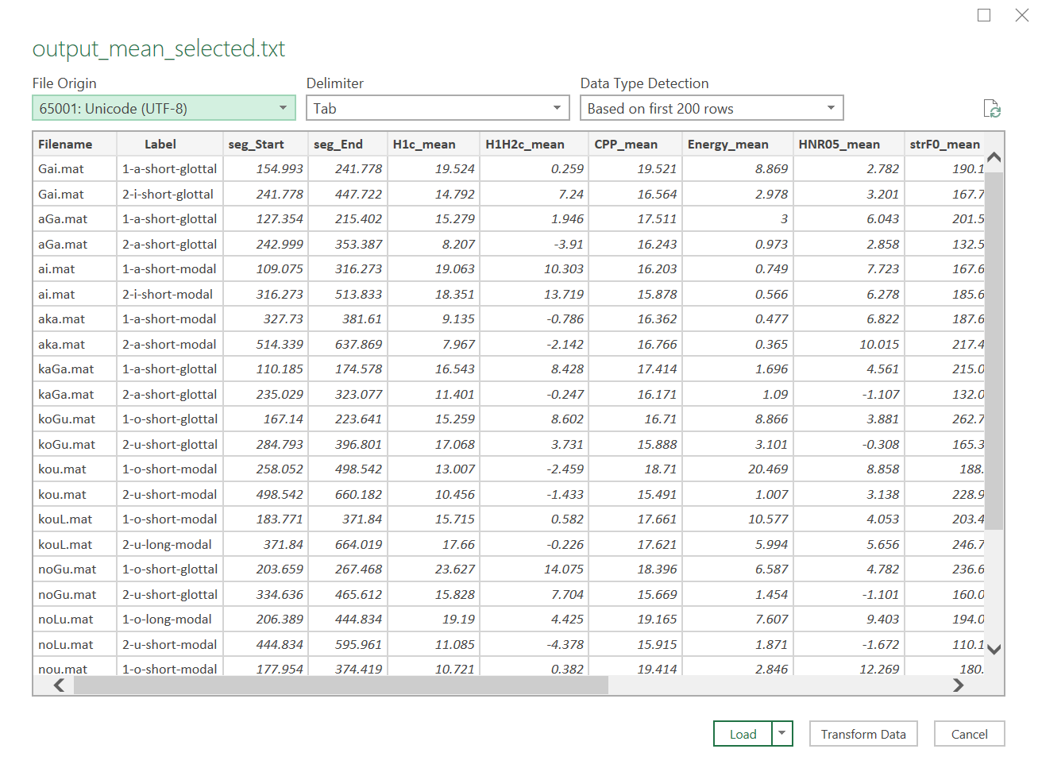

Slide 34
Step 4: Visualize the output in Excel
Open output.txt in Excel:
Open Excel → Data → From Text/CSV;
Load the data;
Save the data file as a .xlsx file.

Slide 35
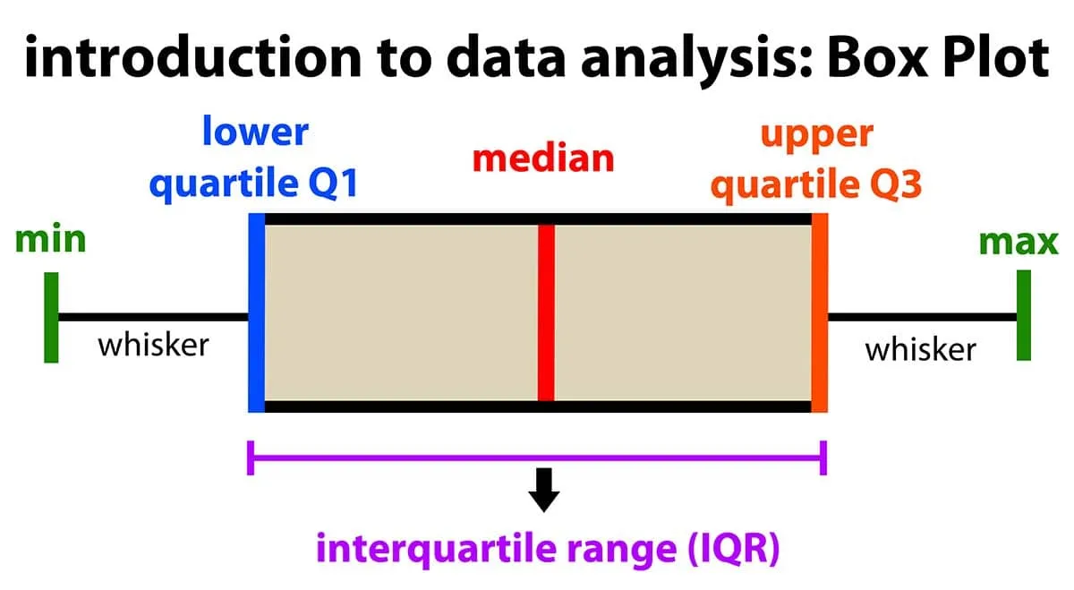
Step 4: Visualize the output in Excel
Draw boxplots:
Boxplots present the median, first and third quantile, and the minimum and maximum of the data.
Picture from https://www.simplypsychology.org/boxplots.html

Slide 36
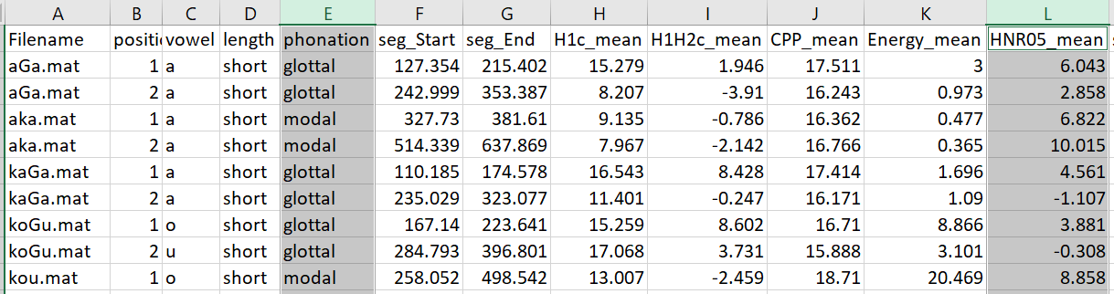
Step 4: Visualize the output in Excel
Draw boxplots: H1-H2 distribution of modal vs. glottalized phonation
Select the column of “phonation”; Press “ctrl” on the keyboard, and Select the column of “H1H2c_mean”

Slide 37

Step 4: Visualize the output in Excel
Draw boxplots: HNR distribution of modal vs. glottalized phonation
Select the column of “phonation”; Press “ctrl” on the keyboard, and Select the column of “HNR05_mean”
Go to Insert → Charts → All charts → Box & Whisker → Press “OK”

Slide 38
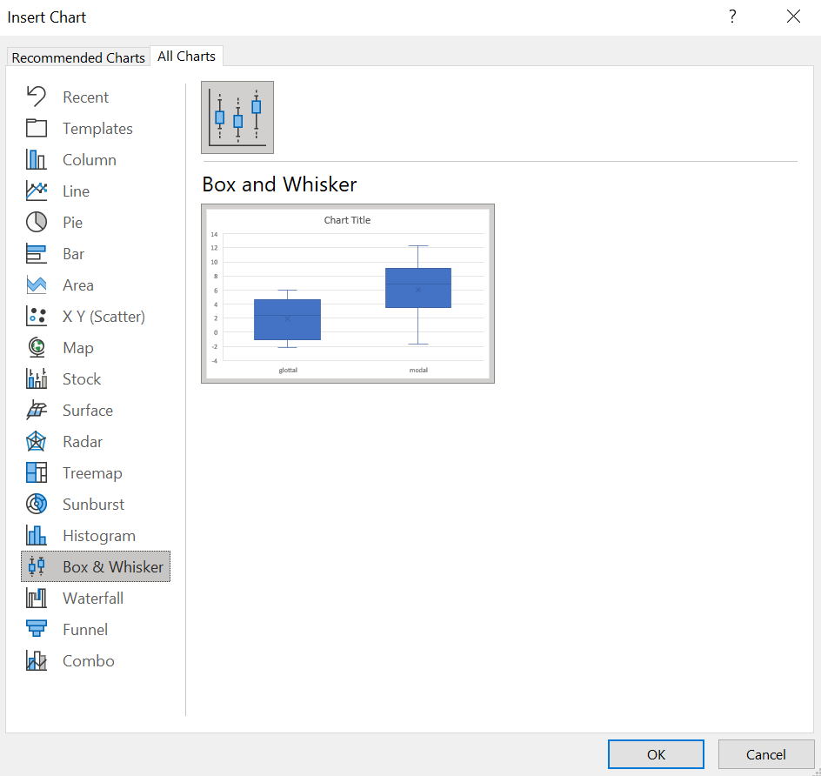

Slide 39
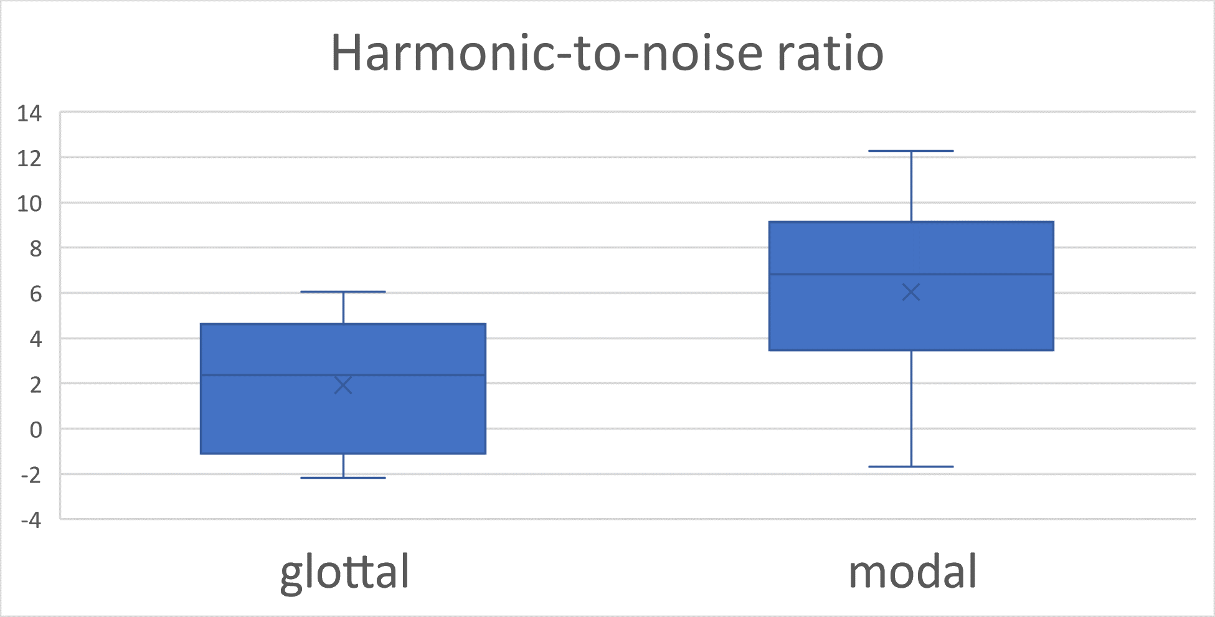
Step 4: Visualize the output in Excel
Draw boxplots: HNR distribution of modal vs. glottalized phonation
More glottalized
We see that vowels surrounding glottal stops have lower HNR than vowels that do not.
This indicates that vowels in VʔV words are more glottalized than vowels in V or VV words.

Slide 40
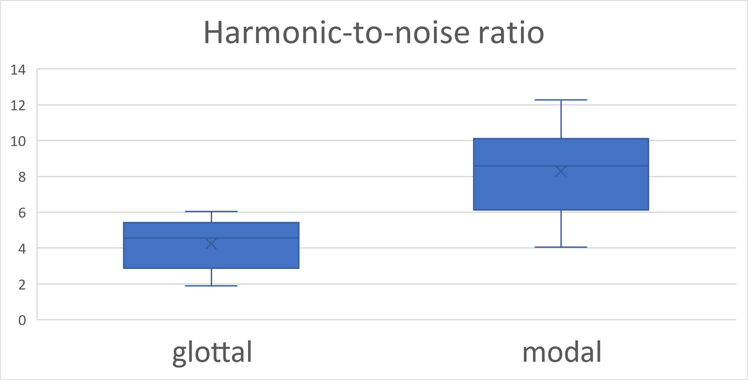
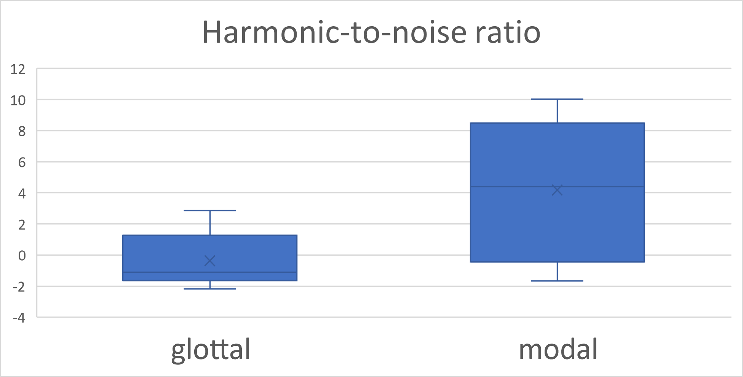
Step 4: Visualize the output in Excel
Draw boxplots: HNR distribution of modal vs. glottalized phonation
You can filter the data and see how the plot changes.
Filter the “position” column by only selecting “1”
Then filter the “position” column by only selecting “2”
Position 1
Position 2
More glottalized

Slide 41
Step 4: Visualize the output in Excel
Let’s try more graphsǃ
Draw boxplots for H1H2c_mean (H1—H2), soe_mean (Strength of Excitation), strF0 (F0 using “straight” algorithm)

Slide 42
Step 4: Visualize the output in Excel
Let’s try drawing graphs in R
R studio online: https://posit.cloud/content/5398051
R script offline: https://yuanchaiyc.github.io/website/subpages/VS-tutorial.Rmd

Slide 43
Take-home message
VoiceSauce is a tool for analyzing acoustics of sound signals;
Its advantage are:
Able to process a large batch of sound files in one sitting;
Able to calculate parameters relating to voice quality;
Able to compare different algorithms for one measure (e.g. F0, formants);
The output is in a tab-delimited format and is ready to be passed on to statistical tests and data visualization.

